Slide 1
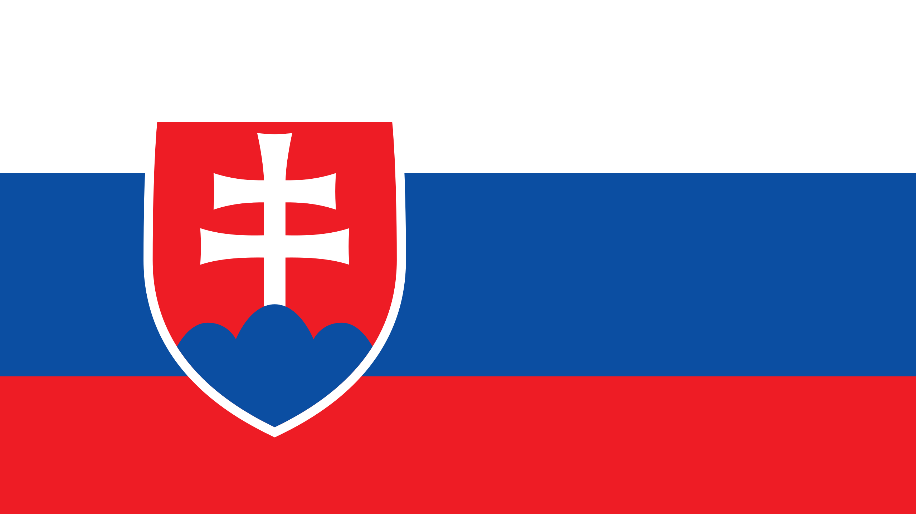

Slide 2
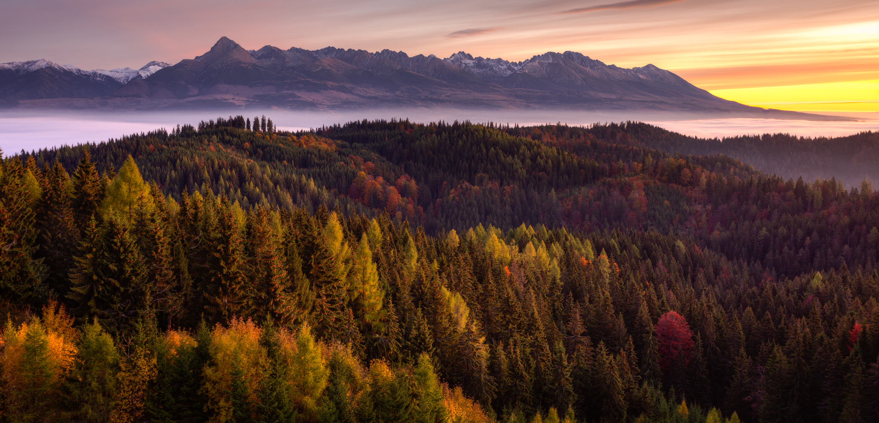
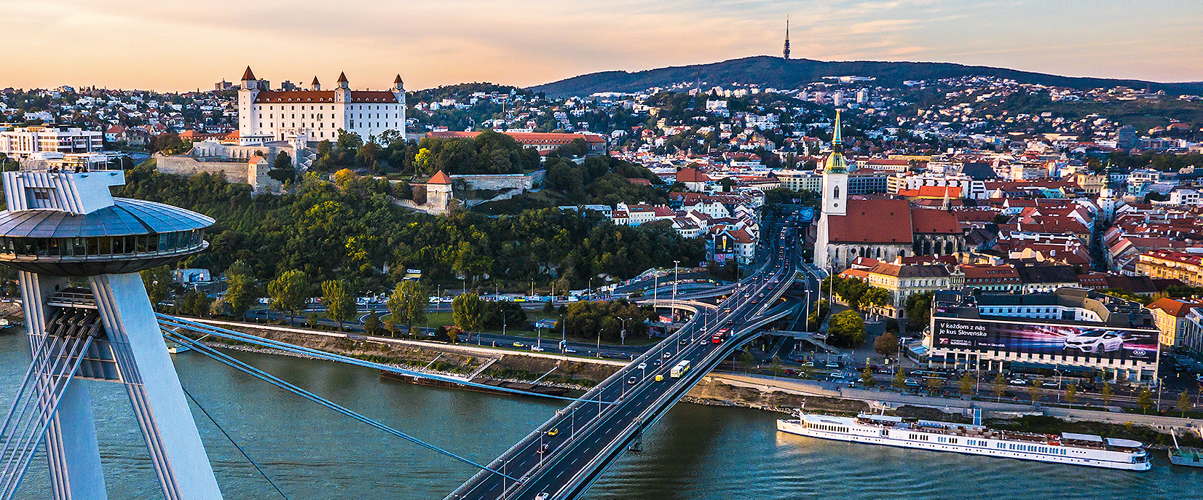
Slovakia
Dávid Zliechovec, Vincent Kokavec, Anna Slaninová, Hana Kovárová

Slide 3
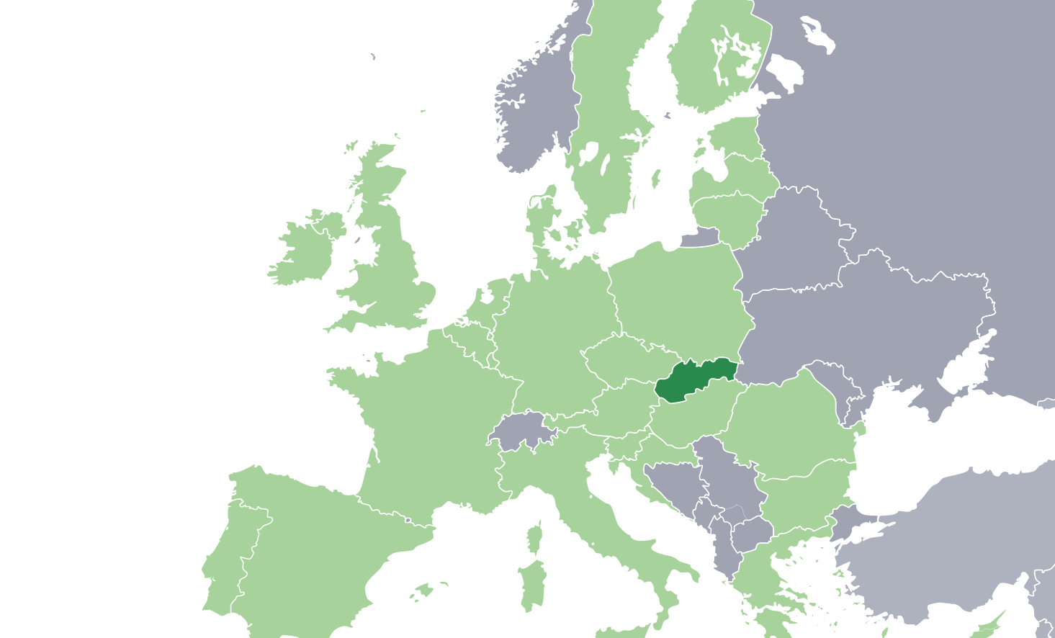
Location
Central Europe
Slovakia

Slide 4
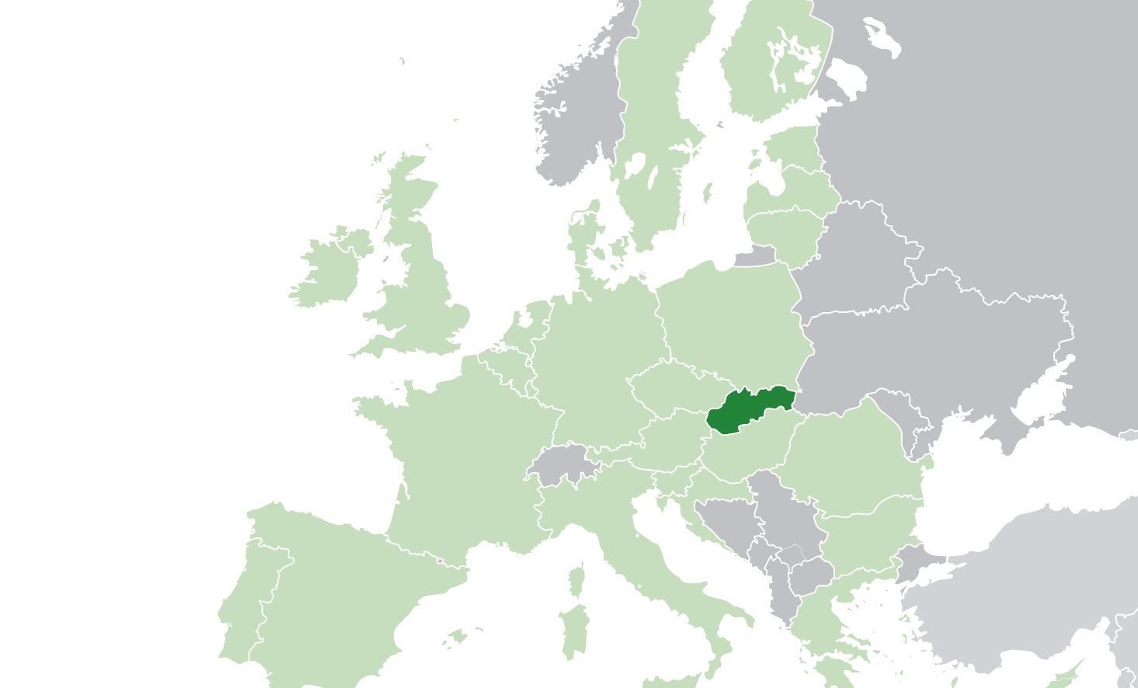
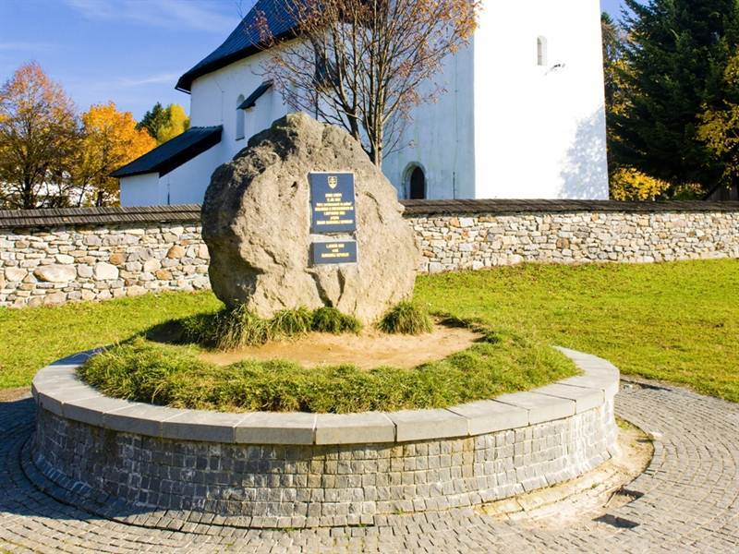
Kremnické bane
Geographical center

Slide 5
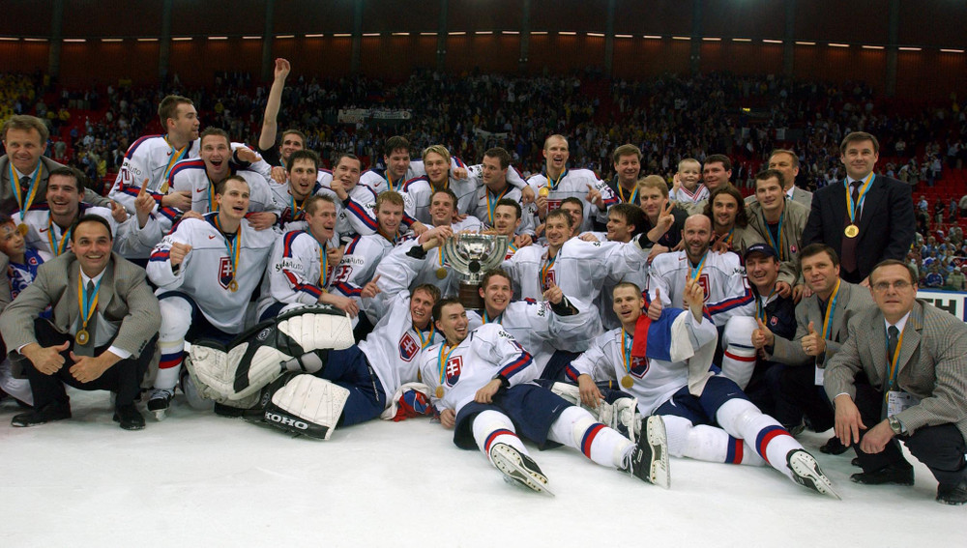
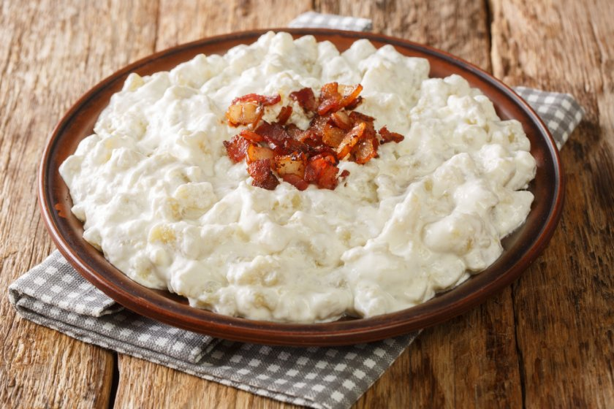
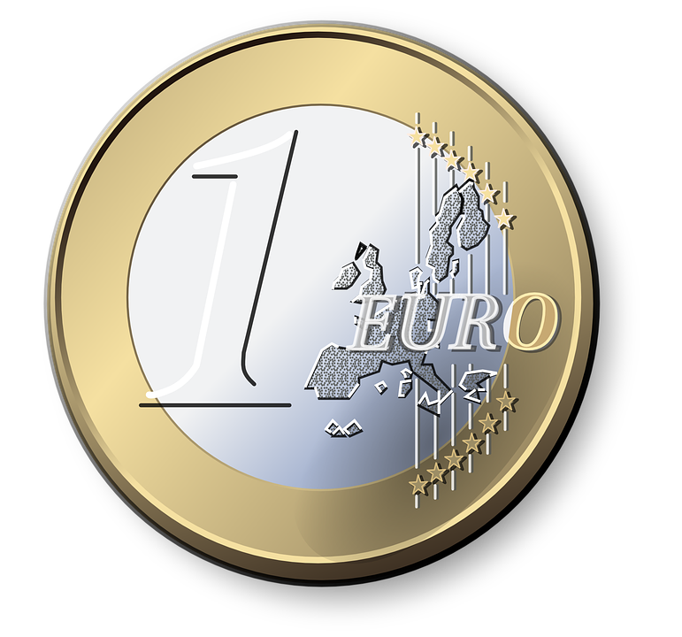
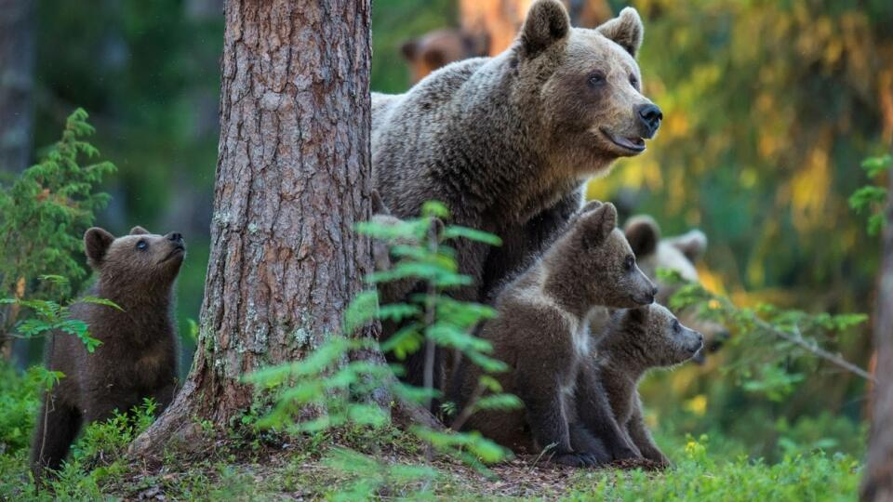
National…
Notes:
Symbolom Slovenska sa stal prvý raz v revolučných rokoch 1848 - 1849. Trojvŕšie symbolizuje tri karpatské pohoria Tatry, Fatru a Mátru (v súčastnosti leží v Maďarsku). Dvojkrížom sa Slovensko hlási ku kresťanstvu a zároveň k tradícii sv. Cyrila a Metoda, ktorí sem v období Veľkej Moravy (9. storočie) priniesli kresťanstvo.

Slide 6
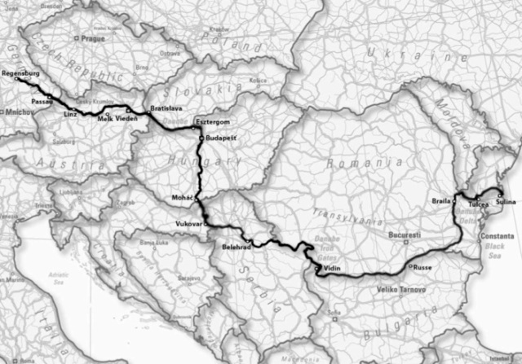
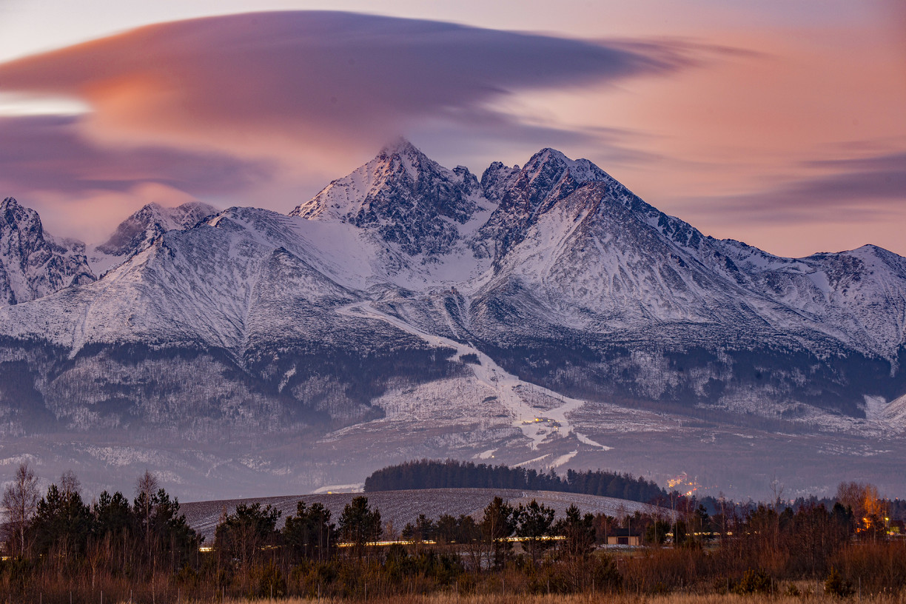
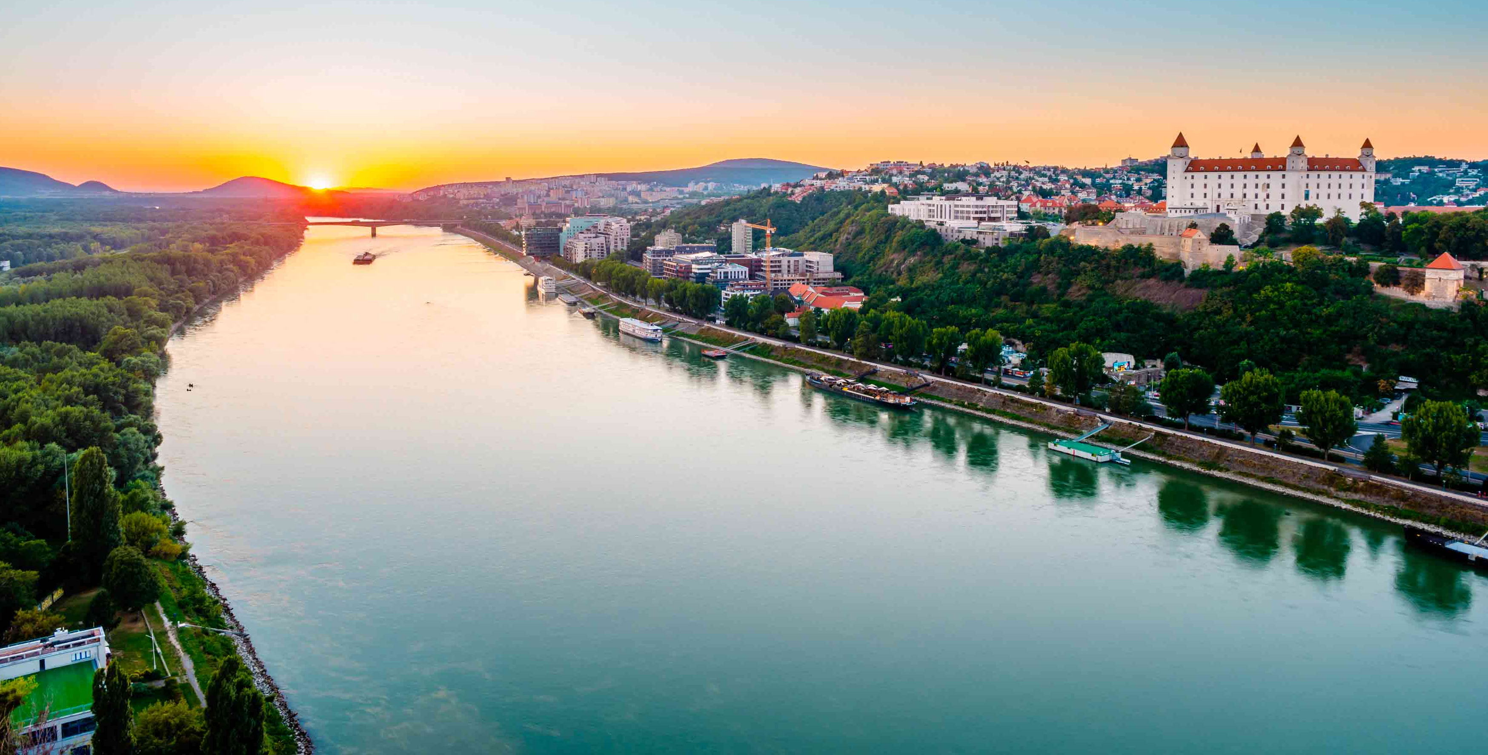
Slovak nature
Danube:
Trading opportunities
Tourism
Sport
Tatras:
Tourism
Rich nature
Ski resorts

Slide 7
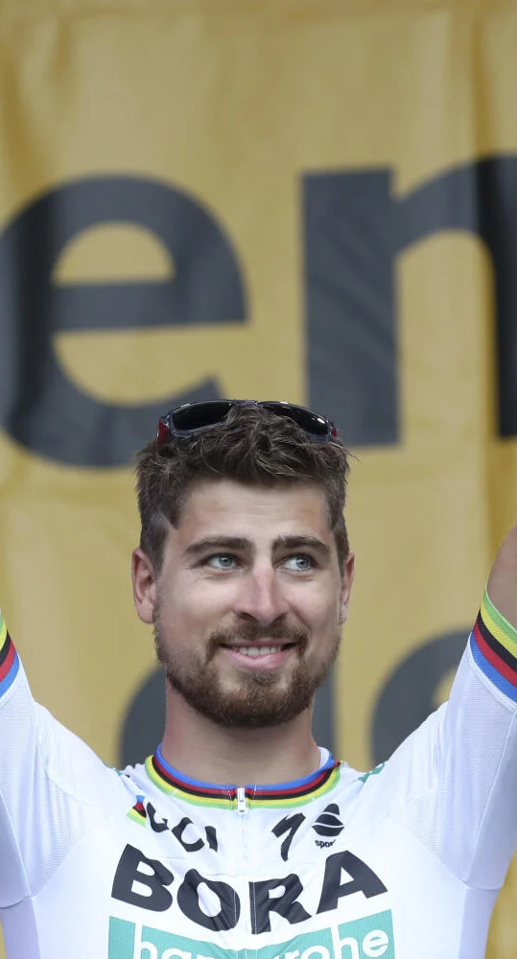
Famous Slovak people
Peter Sagan
* 26. january 1990
professional road bicycle racer
He earned many prestigious victories:
3 World Championships in a row
1 European Championship
17 stages in the Tour of California
15 stages in the Tour de Suisse
12 stages in the Tour de France
And many many more

Slide 8
Population
of Slovakia 5.45 million
of Bratislava 420 000

Slide 9
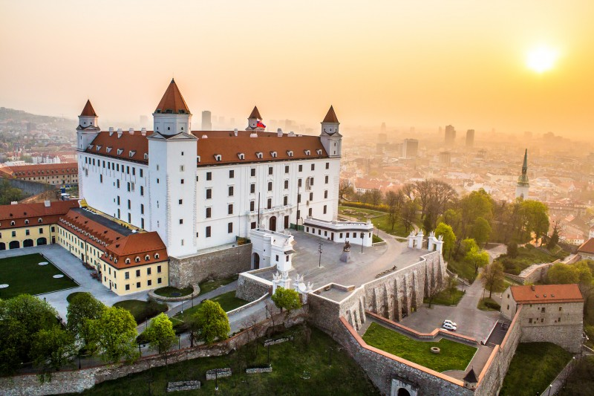
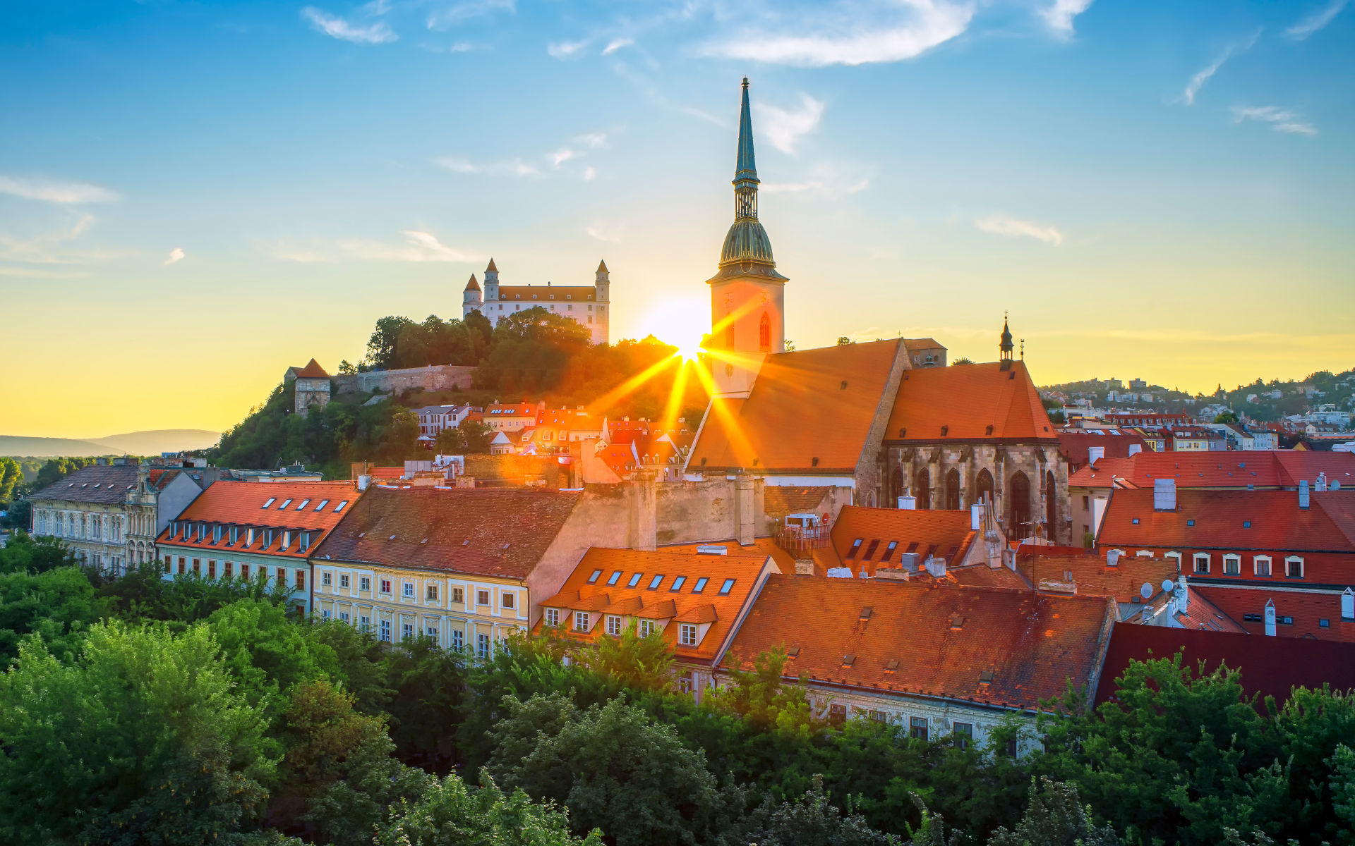
Intresting places in Bratislava The “Ufo” St. Martin´s Cathedral The SND Theater Bratislava Castle

Slide 10
Slovak President
- Slovakia became a state in 1993. - We have had 5 presidents. - Zuzana Čaputová is our current president - She is the first female president in Slovakia.

Slide 11
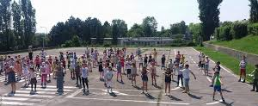
Our school
Karloveska Primary and Secondary School
Age 6 - 15
1st - 9th grade
550 students
77 members of staff
53 teachers

