Slide 1
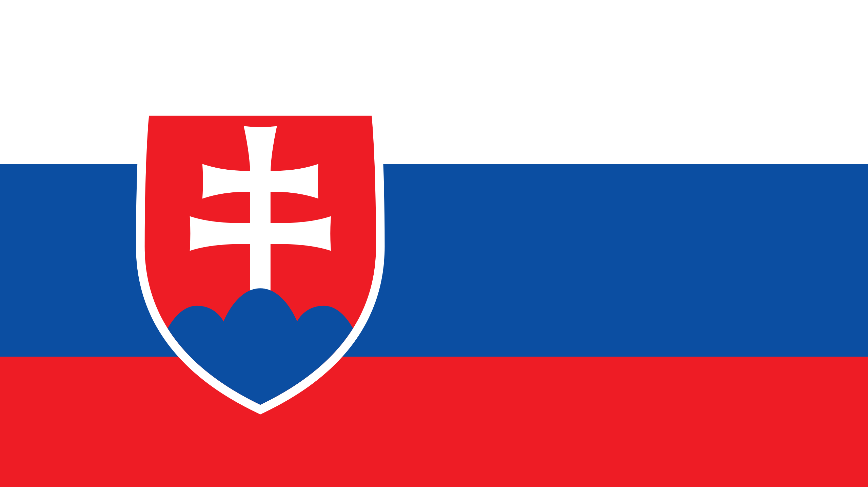

Slide 2
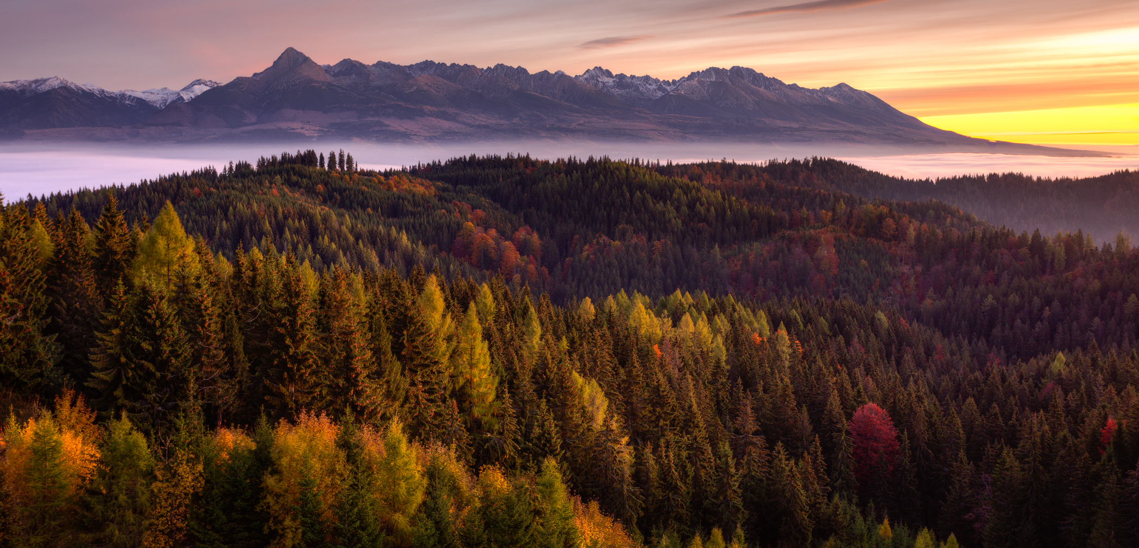
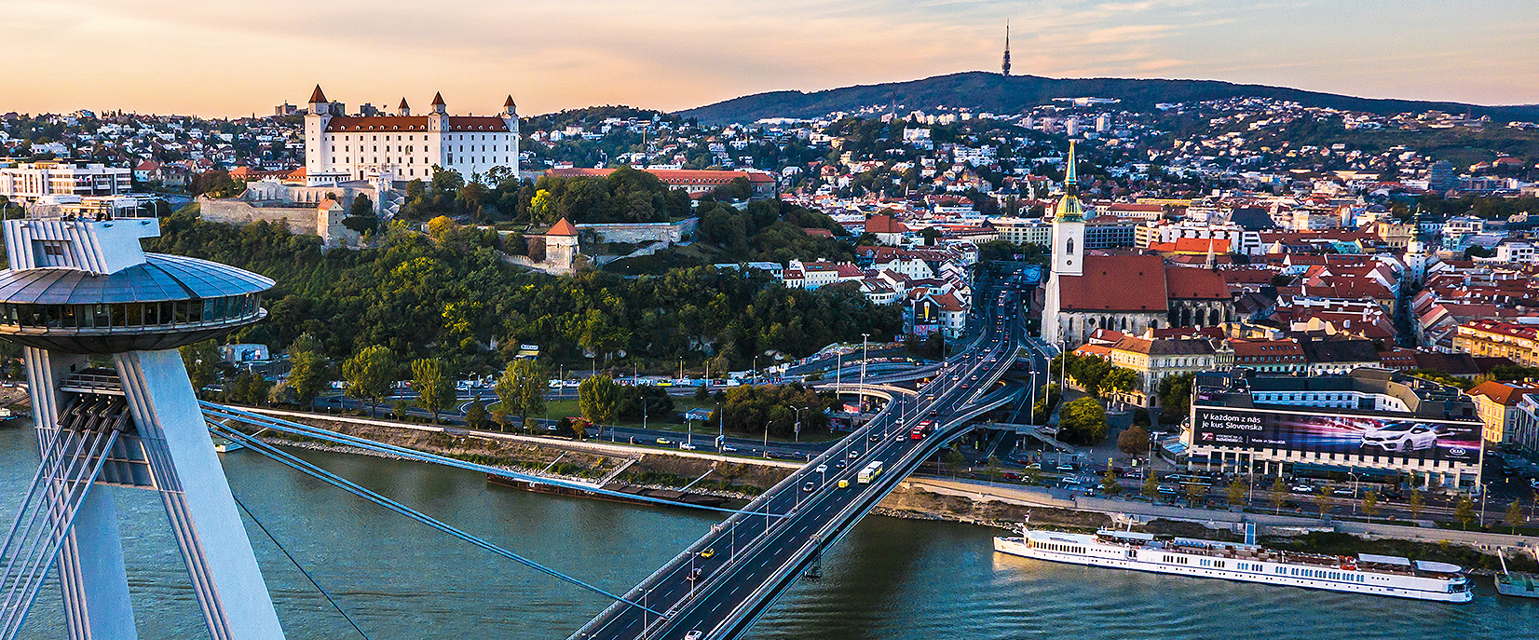
Slovakia
Dávid Zliechovec, Vincent Kokavec, Anna Slaninová, Hana Kovárová

Slide 3
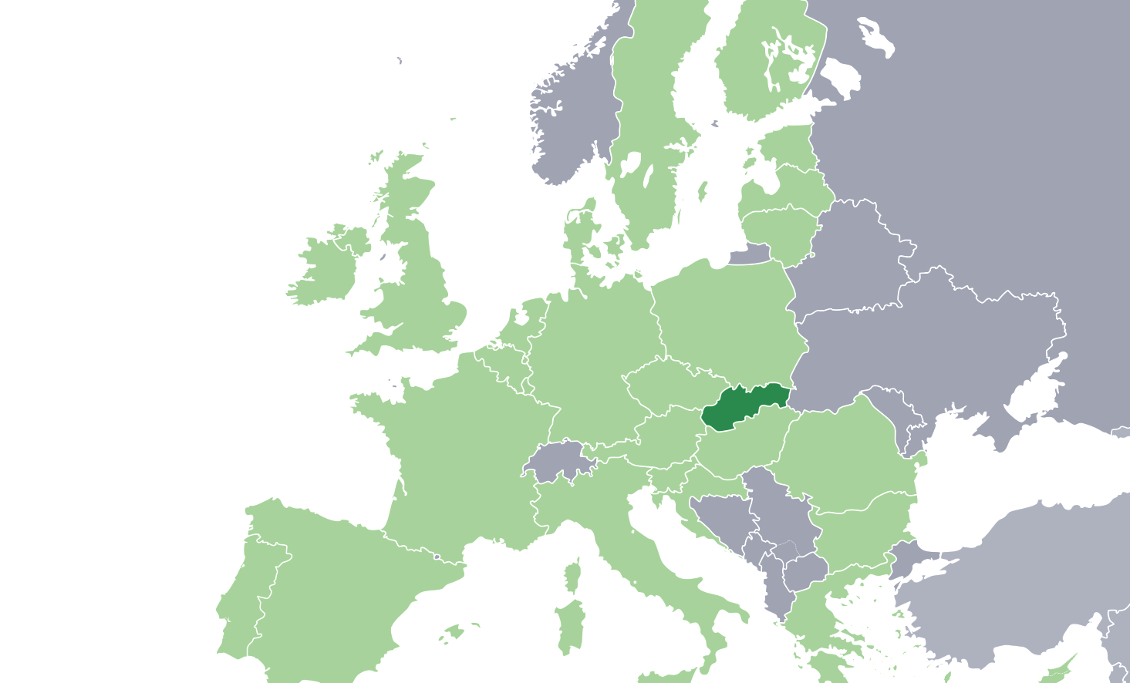

Location
Central Europe
Slovakia

Slide 4
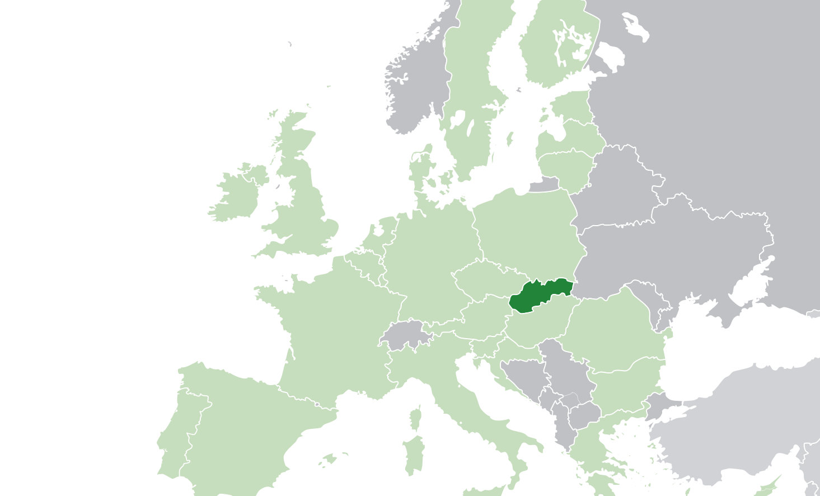
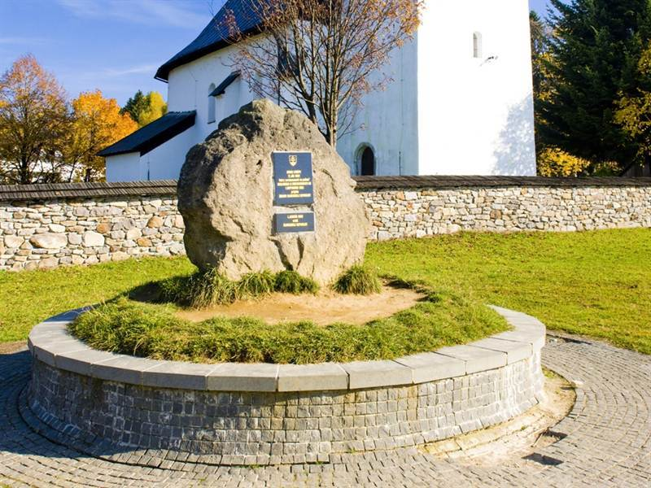
Kremnické bane
Geographical center

Slide 5
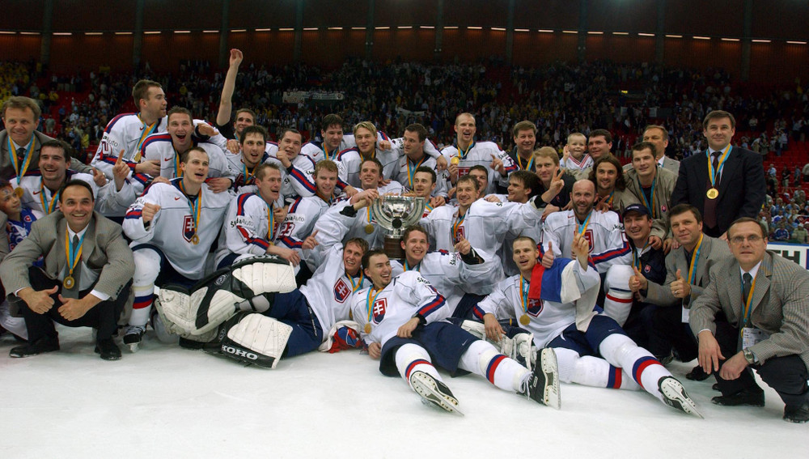
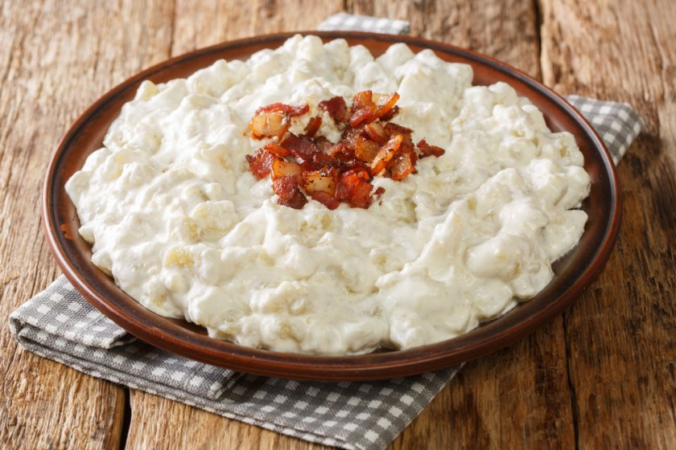
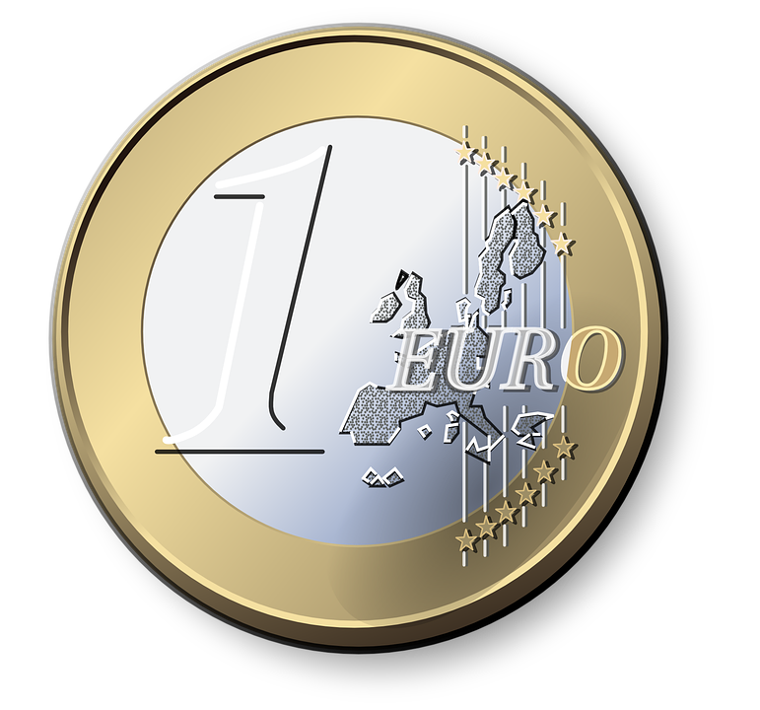

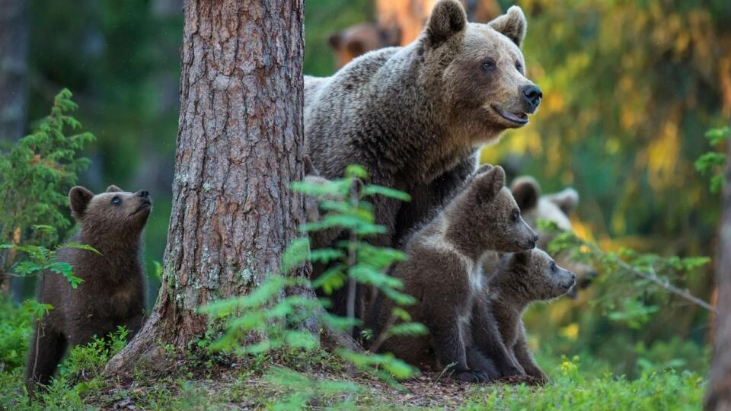
National…
Notes:
Symbolom Slovenska sa stal prvý raz v revolučných rokoch 1848 - 1849.
Trojvŕšie symbolizuje tri karpatské pohoria Tatry, Fatru a Mátru (v súčastnosti leží v Maďarsku).
Dvojkrížom sa Slovensko hlási ku kresťanstvu a zároveň k tradícii sv. Cyrila a Metoda, ktorí sem v období Veľkej Moravy (9. storočie) priniesli kresťanstvo.

Slide 6
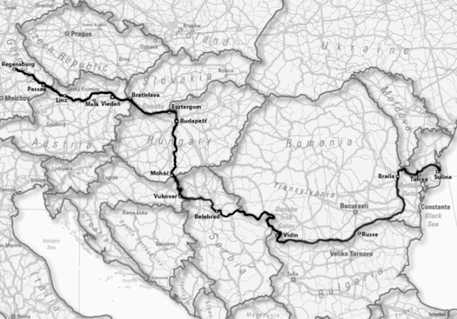
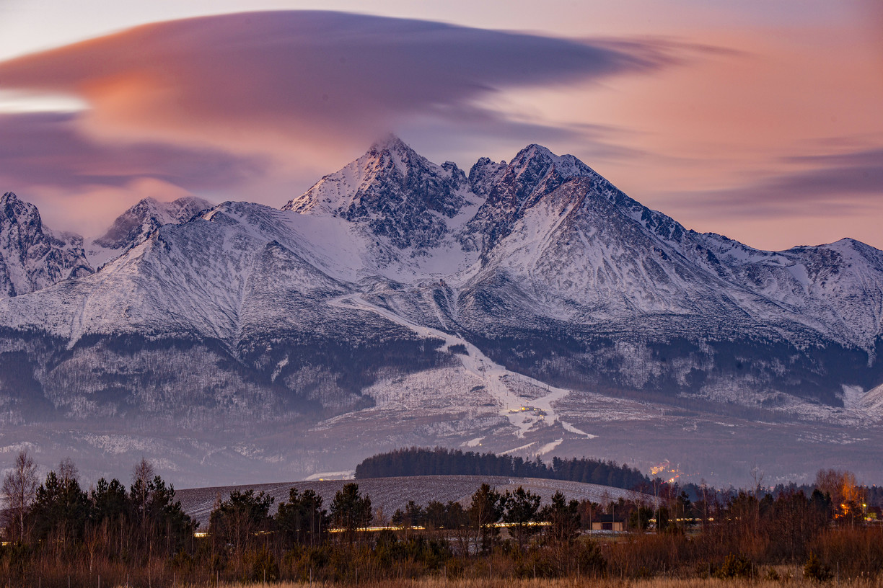
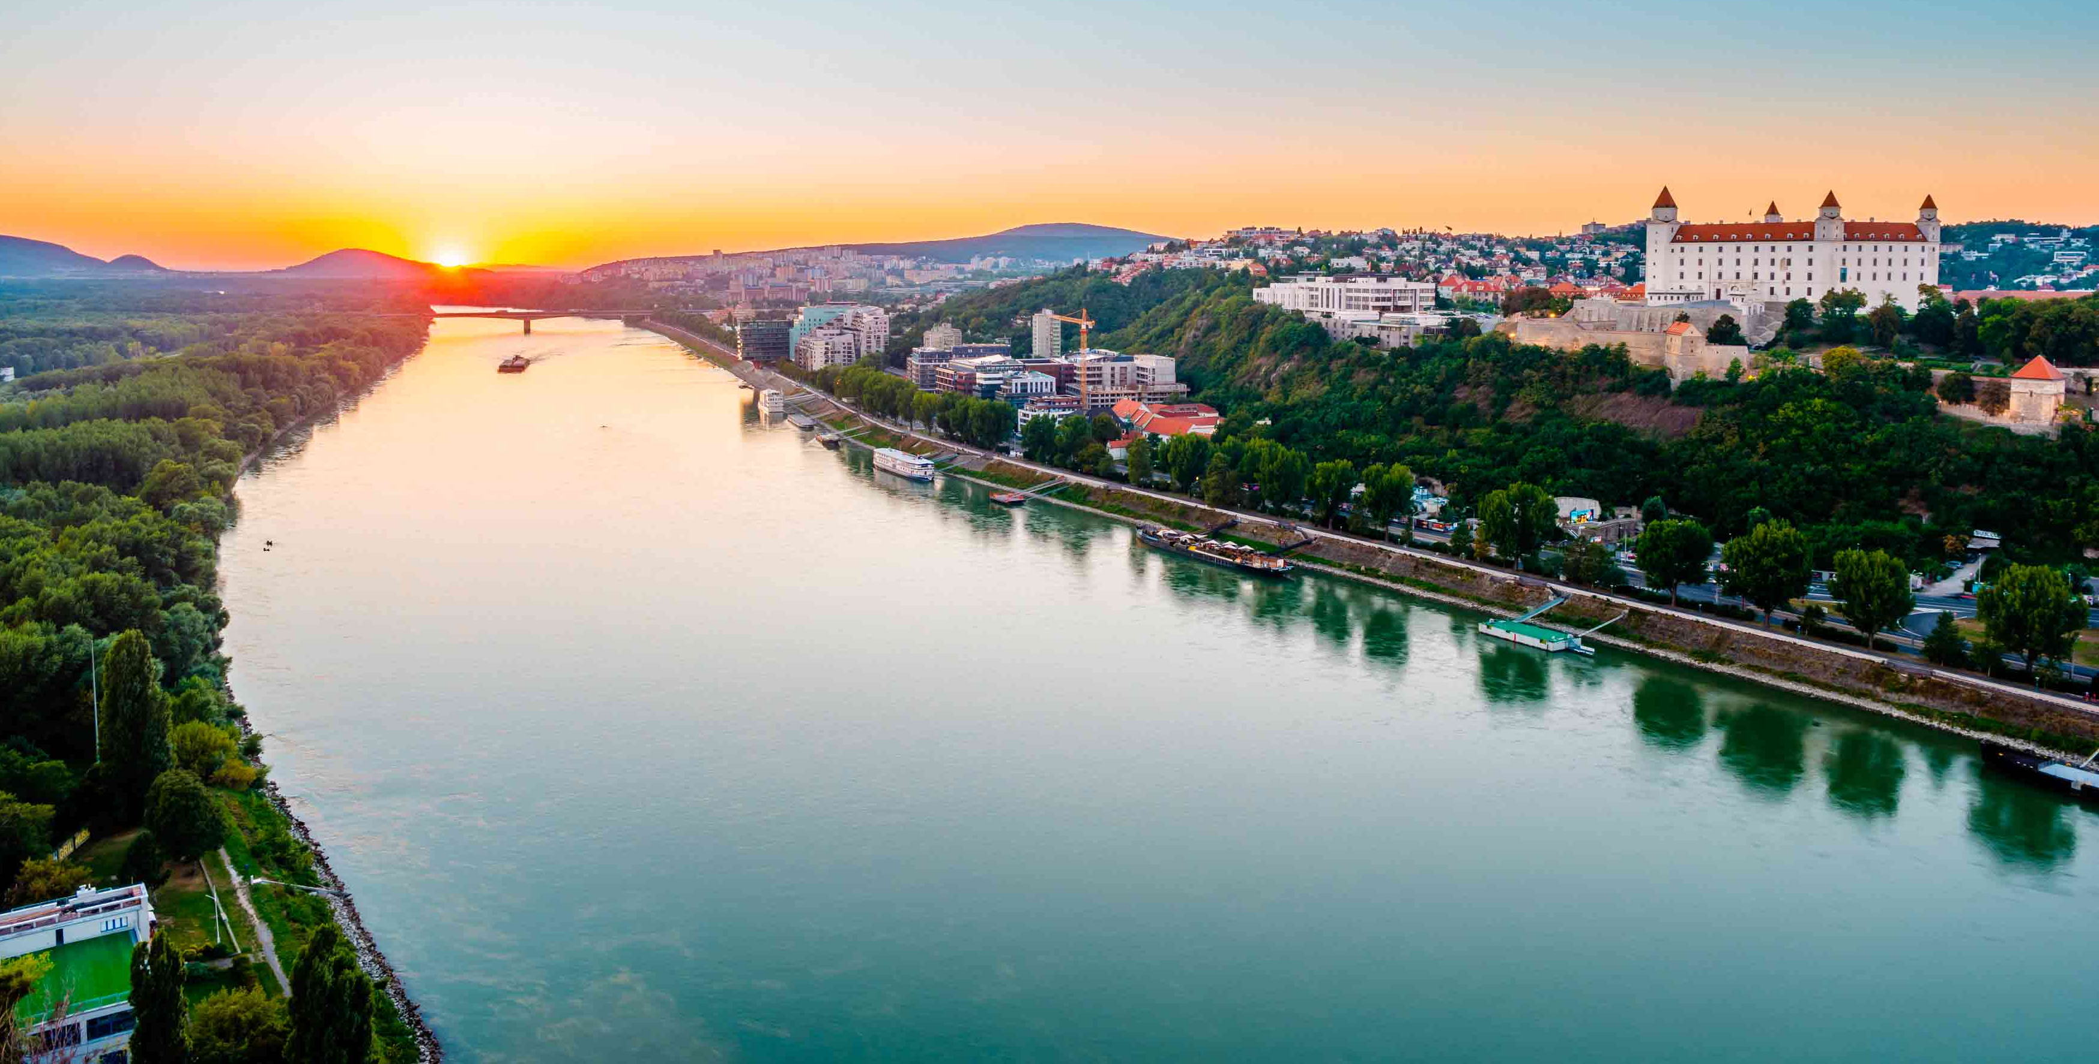
Slovak nature
Danube:
    Trading opportunities
    Tourism
    Sport
Tatras:
  Tourism
  Rich nature
  Ski resorts

Slide 7
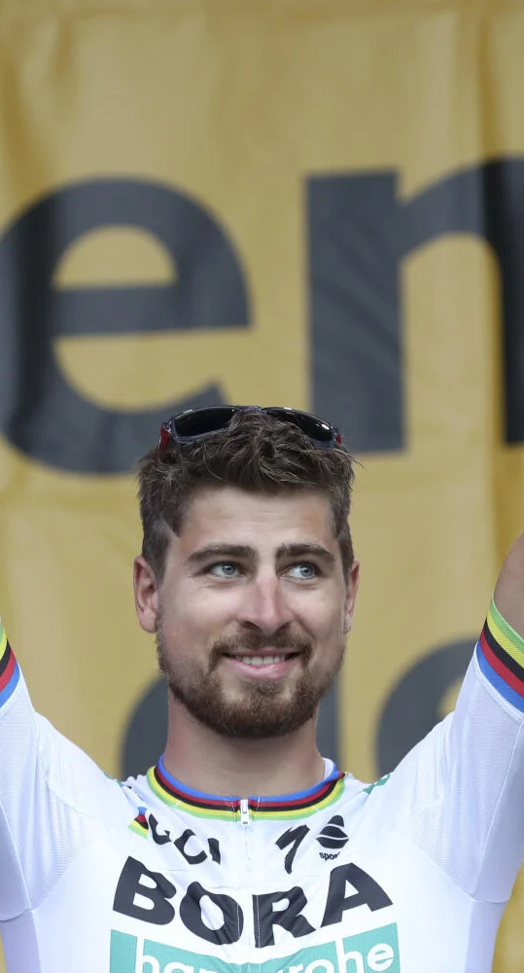
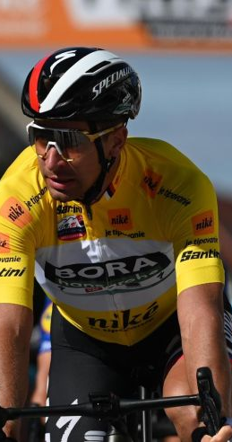
Famous Slovak people
Peter Sagan
* 26. january 1990
professional road bicycle racer
He earned many prestigious victories:
      3 World Championships in a row
      1 European Championship
      17 stages in the Tour of California
      15 stages in the Tour de Suisse
      12 stages in the Tour de France
      And many many more

Slide 8
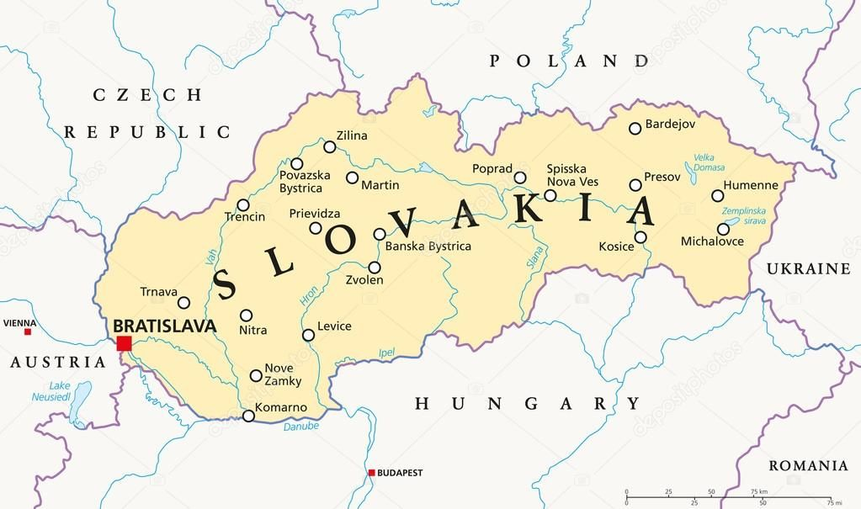
Population
of Slovakia
5.45 million
of Bratislava
420 000

Slide 9
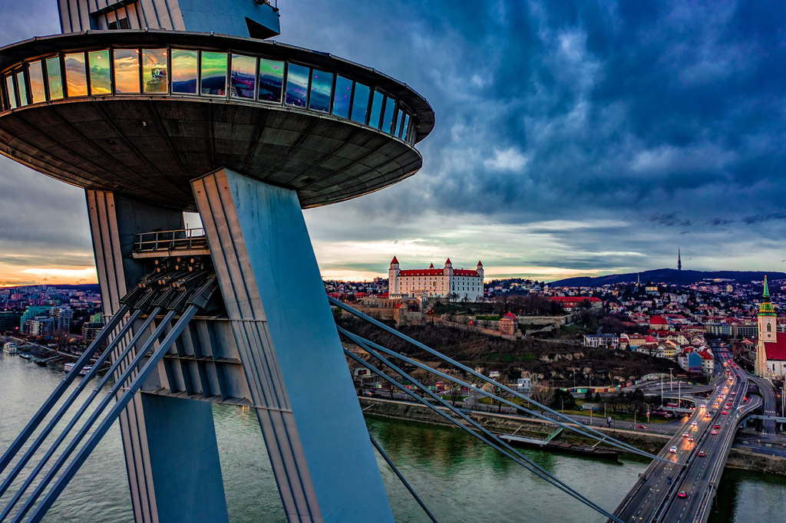
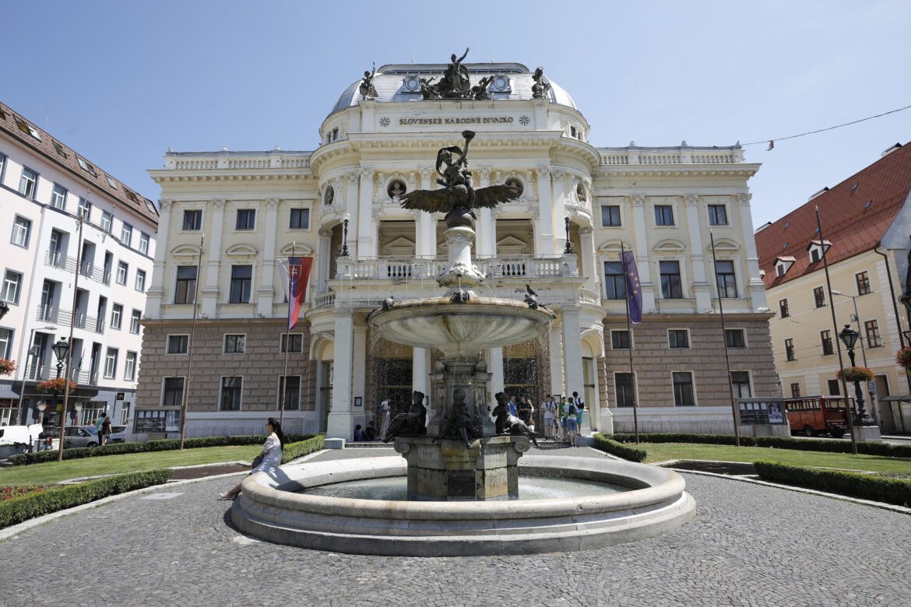
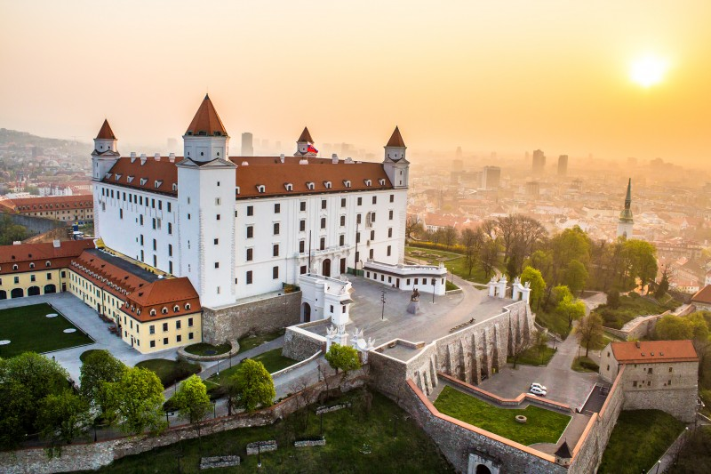
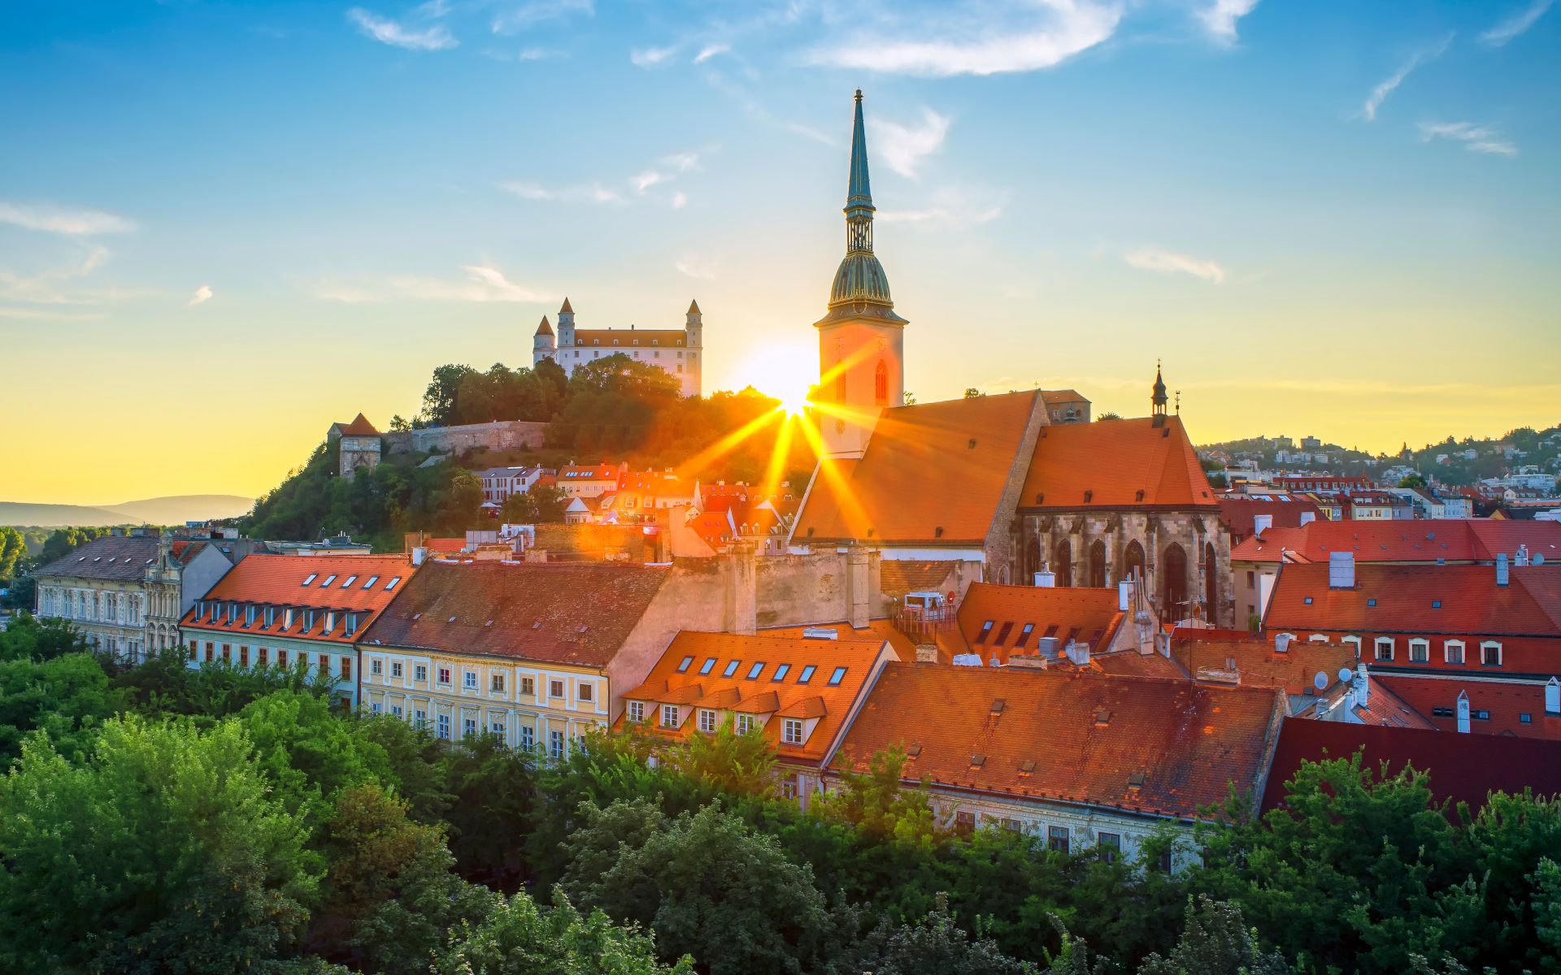
Intresting places in Bratislava
The “Ufo”
St. Martin´s Cathedral
The SND Theater
Bratislava Castle

Slide 10
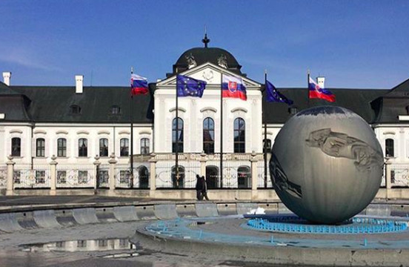
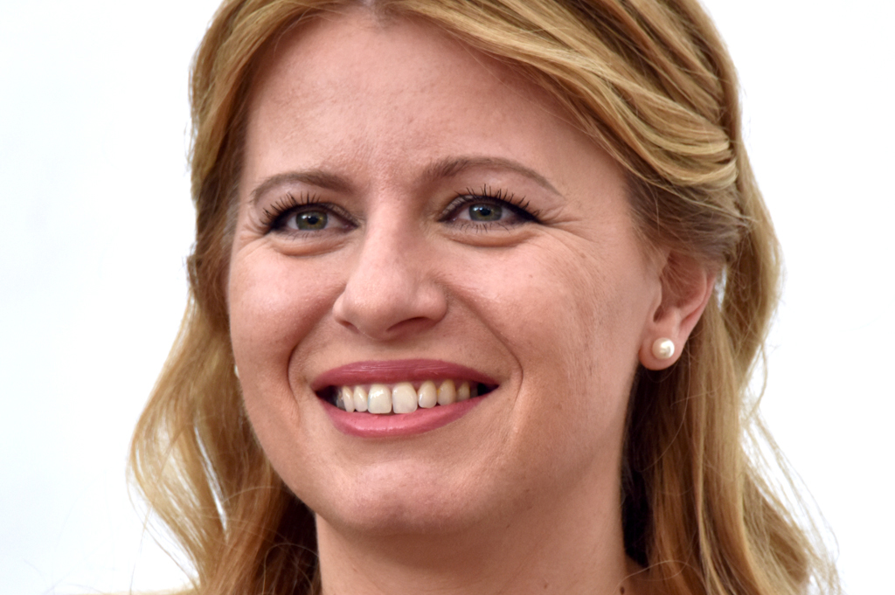

Slovak President
- Slovakia became a state in 1993.
- We have had 5 presidents.
- Zuzana Čaputová is our current president
- She is the first female president in Slovakia.

Slide 11
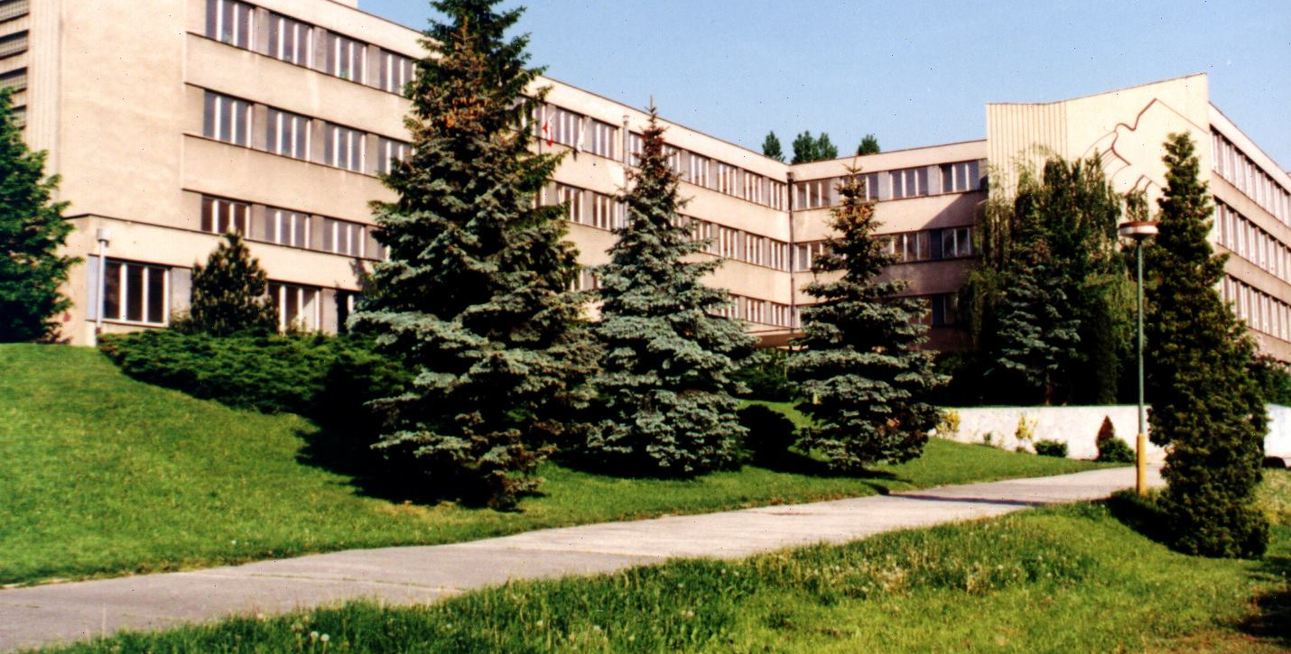

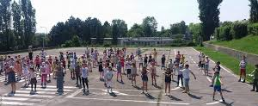
Our school
Karloveska Primary and Secondary School
Age 6 - 15
1st - 9th grade
550 students
77 members of staff
53 teachers

