Slide 1
Portuguese Educational System

Slide 2
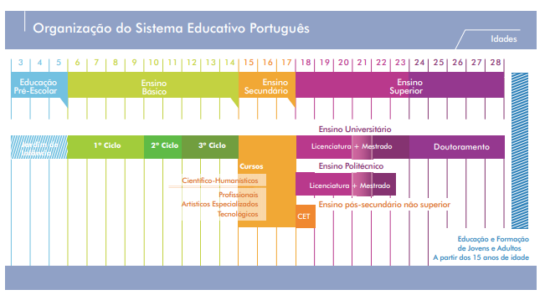
The Portuguese Educational System comprises pre-school education and basic, secondary and higher education.

Slide 3
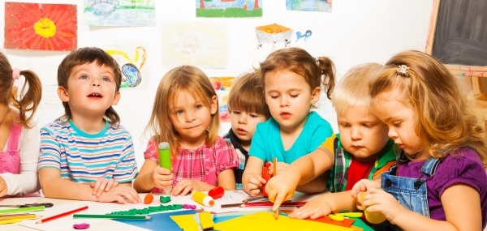
Pres-school Education Attending pre-school education is optional, with students from the age of three until the start of basic education

Slide 4

Basic Education includes three sequential cycles:
The primary school (4 years) with attendance age from 6 to 10 years old;
the 2nd cycle (2 years), with the expected age of attendance, from 10 to 12 years old;
The 3rd cycle (3 years) with the expected age of attendance of 12 to 15 years old.

Slide 5

Secondary education corresponds to a 3-year cycle and has the expected age of attendance from 15 to 18 years old. It includes five types of courses:
Scientific-Humanistic Courses;
Professional courses;
Specialized Art Courses
Courses with their own plans (Scientific-Technological Courses)
Education and Training courses for young people.

Slide 6

Basic and secondary education are compulsory, universal and free to all students.

Slide 7
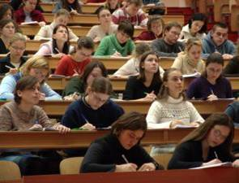
Higher education is structured under the principles of the Declaration of Bologna and is taught in polytechnic institutes and universities, whether public, private or cooperative.

Slide 8
Webgrafia:
https://eacea.ec.europa.eu/national-policies/eurydice/content/organisation-education-system-and-its-structure-60_pt-pt

